Slide 1
MLOps
Anshu Pandey

Slide 2

Introduction
Anshu Pandey
AI & Data Consultant
10+ years of experience as Data Scientists, AI Consultant and Architect
MCT, WCT, 10+ other certifications

Slide 3

Introduction
Tell more about yourself
Your experience with
python, Azure cloud
Machine Learning
Your expectation from this course

Slide 4
Common challenges with ML
Cross-team alignment: Siloed teams impede workflow alignment and collaboration.
Standard, repeatable processes: Without automated and repeatable processes, employees have to reinvent the wheel each time they create and deploy a new model.
Resources: Large amounts of time and personnel are required to manage the lifecycle.
Auditability: It can be difficult to ensure that models meet regulatory standards and performance thresholds over time.
Explainability: Black box models make it difficult to understand how the model works.

Slide 5
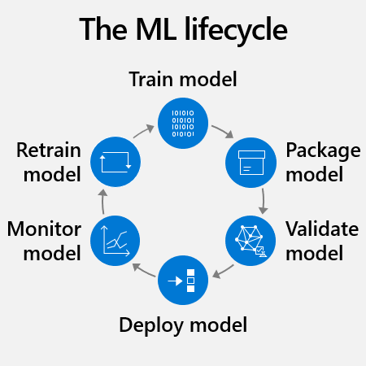
Typical ML model lifecycle

Slide 6
What is MLOps?
MLOps stands for Machine Learning Operations. It is an approach to managing the lifecycle of machine learning models that emphasizes collaboration, automation, and monitoring.
MLOps aims to bridge the gap between data science and IT operations by applying principles and practices from software engineering to machine learning development and deployment.
MLOps involves various tasks, such as data preparation, model training, deployment, monitoring, and maintenance, and relies on tools and technologies such as version control, continuous integration and deployment (CI/CD), containerization, and orchestration platforms.
MLOps helps organizations to build and deploy machine learning models more efficiently, reliably, and at scale, while reducing risks and costs associated with machine learning projects.

Slide 7
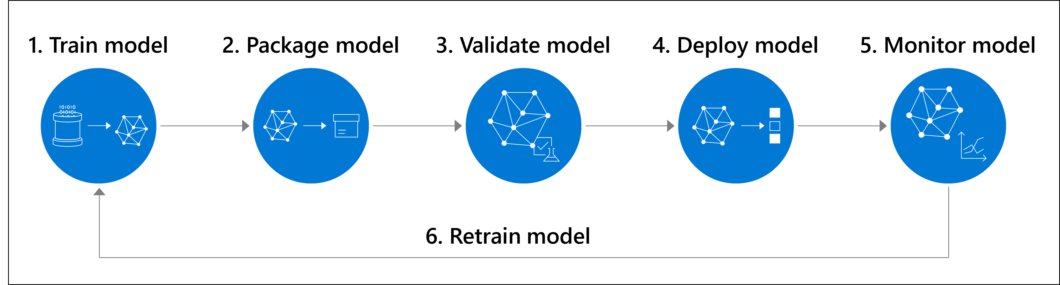
What is MLOps?
Machine learning operations or MLOps aims to more efficiently scale from a proof of concept or pilot project to a machine learning workload in production.

Slide 8
Why MLOps
Improved collaboration: MLOps promotes collaboration between data scientists, software engineers, and operations teams, enabling them to work together more effectively and efficiently
Faster time to market: By automating many of the tasks involved in model development and deployment, MLOps can help organizations bring new machine learning models to market more quickly.
Better model performance: MLOps emphasizes continuous monitoring and optimization of machine learning models, helping to ensure that they continue to operate effectively over time.
Reduced costs: By automating many of the tasks involved in model development and deployment, MLOps can help organizations reduce the costs associated with managing machine learning models.
Improved reliability: MLOps promotes the use of best practices for testing, deployment, and monitoring, helping to ensure that machine learning models operate reliably in production environments.

Slide 9
Principles of MLOps
Collaboration
MLOps emphasizes collaboration between data scientists, software engineers, and operations teams. By working together, these teams can ensure that machine learning models are built and deployed effectively.
Automation
MLOps promotes the use of automation to streamline the development and deployment of machine learning models. Automation can help to reduce the time and effort required to manage these models, and can improve their reliability and performance.
Version Control
MLOps relies on version control to manage changes to machine learning models and related code. Version control helps to ensure that all changes are tracked and documented, and can help to facilitate collaboration among team members.
Testing
MLOps emphasizes the importance of testing machine learning models to ensure that they are working correctly. Testing can help to identify and address issues before they become problems in production environments.
Monitoring
MLOps promotes continuous monitoring of machine learning models in production environments. This can help to identify issues and opportunities for optimization, and can help to ensure that the models continue to operate effectively over time.
Deployment
MLOps emphasizes the importance of automating the deployment of machine learning models to production environments. This can help to reduce the risk of errors and ensure that models are deployed consistently across different environments.

Slide 10
Tasks involved in MLOps
Data preprocessing
Cleaning, transforming, and organizing data so that it can be used for training and evaluation.
Example: Removing missing values from a dataset, normalizing numerical features, and encoding categorical variables.
Model selection
Choosing the appropriate algorithm and hyperparameters to create models that meet specific business and technical requirements.
Example: Deciding whether to use a linear regression or a decision tree algorithm to predict sales, and selecting appropriate values for parameters such as learning rate or regularization.
Model training
Using data to train models, and optimizing them for specific use cases.
Example: Using historical sales data to train a machine learning model that predicts future sales, and adjusting the model's parameters to maximize accuracy.

Slide 11
Tasks involved in MLOps
Model Testing
Integrating models into production environments, often using containerization technologies such as Docker, and ensuring they can scale and operate reliably.
Example: Deploying a machine learning model as a web service that can be accessed by other applications, and monitoring its performance to ensure it meets service level agreements.
Model monitoring
Collecting and analyzing data on model performance, identifying potential issues or problems, and responding quickly to minimize any impact on users.
Example: Monitoring a machine learning model's predictions over time, and detecting if its accuracy starts to degrade or if it starts to produce biased results.
Model optimization
Continuously improving models by refining algorithms, tweaking hyperparameters, and incorporating new data or feedback from users.
Example: Incorporating customer feedback into a machine learning model that recommends products, and adjusting the model's parameters to better reflect user preferences.
Model deployment
Model explanation, Biasness Analysis, Fairness Analysis, response time, packaing, environment, dependencies etc.
Example: Performing detailed testing on model to ensure it matches business requirements

Slide 12
Tools for MLOps
Mlflow
MLflow is an open-source platform for managing the lifecycle of machine learning models. It provides tools for tracking experiments, packaging code, and deploying models.
Apache Airflow
Apache Airflow is an open-source platform for creating, scheduling, and monitoring workflows. It provides a way to automate the steps involved in building and deploying machine learning models, including data ingestion, model training, and model deployment.

Slide 13
Tools for MLOps
Docker
Docker is a containerization platform that is commonly used in MLOps to package and deploy machine learning models. With Docker, machine learning models can be packaged into a container image, along with all the dependencies needed to run the model. This makes it easy to deploy the model to any environment that supports Docker, such as a cloud platform or on-premise server.
Kubeflow
Kubeflow is an open-source platform for building and deploying machine learning workflows on Kubernetes. It provides tools for model training, serving, and monitoring, as well as tools for managing data pipelines and model artifacts.

Slide 14


Overview of MLFlow
What is MLFlow?
MLFlow is an open-source platform for managing the ML lifecycle, including experimentation, reproducibility, deployment, and model tracking.
It offers tools for tracking experiments, model management, and scaling deployment.
Key Components
MLFlow Tracking: Logs and tracks parameters, metrics, and models during experiments.
Model Registry: Centralized place to store and version models.
MLFlow Projects: Helps with project organization and reproducibility.

Slide 15
Experiment Tracking with MLFlow
What is Experiment Tracking?
Experiment tracking in MLFlow allows you to log and organize the results of different model runs, helping data scientists track changes to models over time.
MLFlow’s experiment tracking enables you to track key information like hyperparameters, model performance metrics, and output artifacts (models, plots, etc.).
Why Use Experiment Tracking?
Reproducibility: Ensures that every experiment can be reproduced exactly, making it easier to debug and iterate.
Comparability: Allows easy comparison between experiments and their outcomes, helping choose the best performing model.
Traceability: Enables understanding of how changes in hyperparameters, features, and other settings impact model performance.
Implementation Example
mlflow.start_run(): Start tracking an experiment run.
mlflow.log_param(): Log model parameters like learning_rate.
mlflow.log_metric(): Track performance metrics like accuracy.
mlflow.log_artifact(): Save artifacts such as trained model files.

Slide 16
Key Features of MLFlow
MLFlow Tracking
Logs all relevant information during model training, including hyperparameters, metrics, artifacts, and even the source code version.
Tracks experiments over time to compare models with different configurations.
Model Registry
Centralized storage for machine learning models, providing version control, tracking the lifecycle of models (e.g., from Staging to Production), and promoting models to production when they meet performance standards.
MLFlow Projects
Reusable code: Encapsulate ML code in a standard format with MLproject files for portability.
Allows the use of environment definitions to ensure that experiments are executed in the same way across different systems.
MLFlow Models
Helps in managing and sharing models by allowing deployment on multiple platforms, including cloud and edge devices.
Can work with multiple ML libraries (e.g., TensorFlow, PyTorch, Scikit-learn) and provide a unified API for deployment.

Slide 17






Using MLFlow to Track Experiments
Setting Up Tracking
Create an experiment using mlflow.create_experiment() to organize your model runs.
Use mlflow.start_run() to start tracking parameters and metrics for each individual experiment.
Logging Details
Parameters: Log hyperparameters like batch_size, epochs, etc. These can influence model performance and are vital for reproducibility.
Metrics: Track performance metrics (accuracy, AUC, etc.). This helps in comparing different runs.
Artifacts: Save your model, training data, or any other files (e.g., confusion matrix) as artifacts using mlflow.log_artifact().
Tracking Visuals
MLFlow provides a web interface where users can visualize the metrics, compare experiments, and track artifact versions in real-time.

Slide 18

Logging Metrics and Parameters with MLFlow
Importance of Logging
By logging metrics and parameters, you can track model performance and understand the impact of each configuration on the final result.
This data helps compare models and makes it easier to reproduce the best-performing configurations.
Logging Example
mlflow.log_param("max_depth", 10)
mlflow.log_metric("accuracy", 0.95)
This helps track the relationship between hyperparameters and model performance.
Use Cases
Hyperparameter Optimization: Automatically track and log the results of hyperparameter tuning experiments.
Model Comparison: Compare different versions of a model using a consistent set of metrics and parameters.

Slide 19
Custom Metrics in MLFlow
MLFlow supports custom metrics, which are critical when you need to track domain-specific or non-standard metrics that aren’t provided out of the box (e.g., precision at k for ranking models).
Creating Custom Metrics
Define your custom metric using standard Python functions and log them via mlflow.log_metric().
Example
mlflow.log_metric("precision_at_5", custom_precision_at_k(predictions, ground_truth))
Use Cases
Business Metrics: Track metrics like profit margin or customer satisfaction, which are more relevant in specific industries like finance or healthcare.

Slide 20

MLFlow Projects
What Are MLFlow Projects?
MLFlow Projects allow you to standardize and organize your code, ensuring consistency when running experiments across teams or environments.
Project Structure
Use an MLproject file to define dependencies, entry points, and configurations for your experiment.
This file ensures reproducibility by defining the environment and requirements for running the code.
Benefits
Reproducibility: Ensures that every team member or system can run the exact same experiment with consistent results.
Portability: Projects can be executed in any environment with the required dependencies, ensuring that experiments run the same way locally or in the cloud.

Slide 21

Model Registry in MLFlow
What is the Model Registry?
The Model Registry is a central hub for storing machine learning models. It tracks models across different versions, from initial experimentation to production.
Key Features
Model Versioning: Every model has a version number, allowing easy rollback to previous versions.
Stages: Models can be moved between stages like Staging, Production, and Archived, based on evaluation metrics and performance.
Collaborative Workflow: Teams can work together on models, providing visibility and consistency.

Slide 22
Handling Model Drift in MLOps
What is Model Drift?
Model drift occurs when the model’s performance degrades over time due to changes in the data distribution or environment.
Handling Drift
Use real-time monitoring to detect drift early.
Retrain models periodically or implement online learning to adapt models to new data.
Types of Drift
Data Drift: Occurs when the input data changes, making the model less accurate.
Concept Drift: Occurs when the relationship between input and output changes, rendering the model’s predictions unreliable.

Slide 23
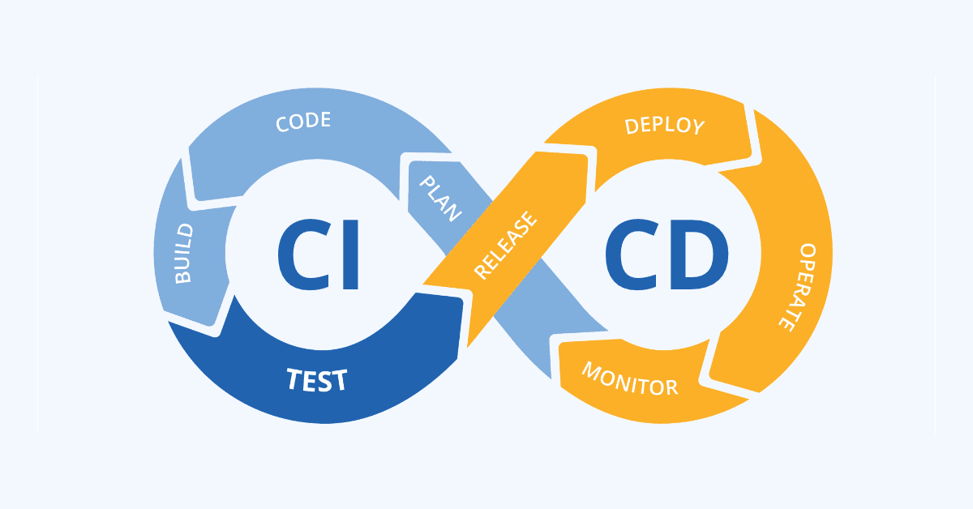
CI/CD in MLOps
Continuous Integration and Continuous Deployment (CI/CD):
In MLOps, CI/CD is critical to automate model deployment and updates.
CI: Automates model testing and validation when code changes occur.
CD: Automates the deployment of models to production after successful validation.
Tools
Jenkins, GitLab CI, CircleCI for automating model deployment.
MLFlow integrates with CI/CD tools to facilitate automated testing, validation, and deployment.
Benefits
Reduces manual intervention and error.
Speeds up the process of delivering new model versions to production.

Slide 24

Model Evaluation and Metrics Tracking
Evaluating Model Performance
Evaluating models involves measuring performance using various metrics, such as accuracy, precision, recall, AUC, and F1 score.
Metrics Tracking with MLFlow
MLFlow helps track these metrics over time and across experiments, making it easier to compare models.
Comparison Example
Compare multiple models by evaluating their performance based on tracked metrics like precision, recall, and AUC, to select the best performing model for deployment.

Slide 25
Mlflow Client API
Mlflow Client API
MLFlow client API is used to interact with mlflow tracking server and perform different operations related to managing experiments and runs.
We now have a client interface to the tracking server that can both send data to and retrieve data from the tracking server.
# importing dependencies
from mlflow import MlflowClient
from pprint import pprint
from sklearn.ensemble import RandomForestRegressor
# configuring the MLflow Tracking Client
client = MlflowClient(tracking_uri="http://127.0.0.1:8080")

Slide 26
Mlflow Client API
Searching Experiments
mlflow.client.MlflowClient.search_experiments() can be used to view metadata of all the experiments on the tracking server.
# searching all experiments
all_experiments = client.search_experiments()
print(all_experiments)
[<Experiment: artifact_location='./mlruns/0', creation_time=None, experiment_id='0', last_update_time=None, lifecycle_stage='active', name='Default', tags={}>]
default_experiment = [
{"name": experiment.name, "lifecycle_stage": experiment.lifecycle_stage}
for experiment in all_experiments
if experiment.name == "Default"][0]
pprint(default_experiment)
{'name': 'Default', 'lifecycle_stage': 'active'}

Slide 27
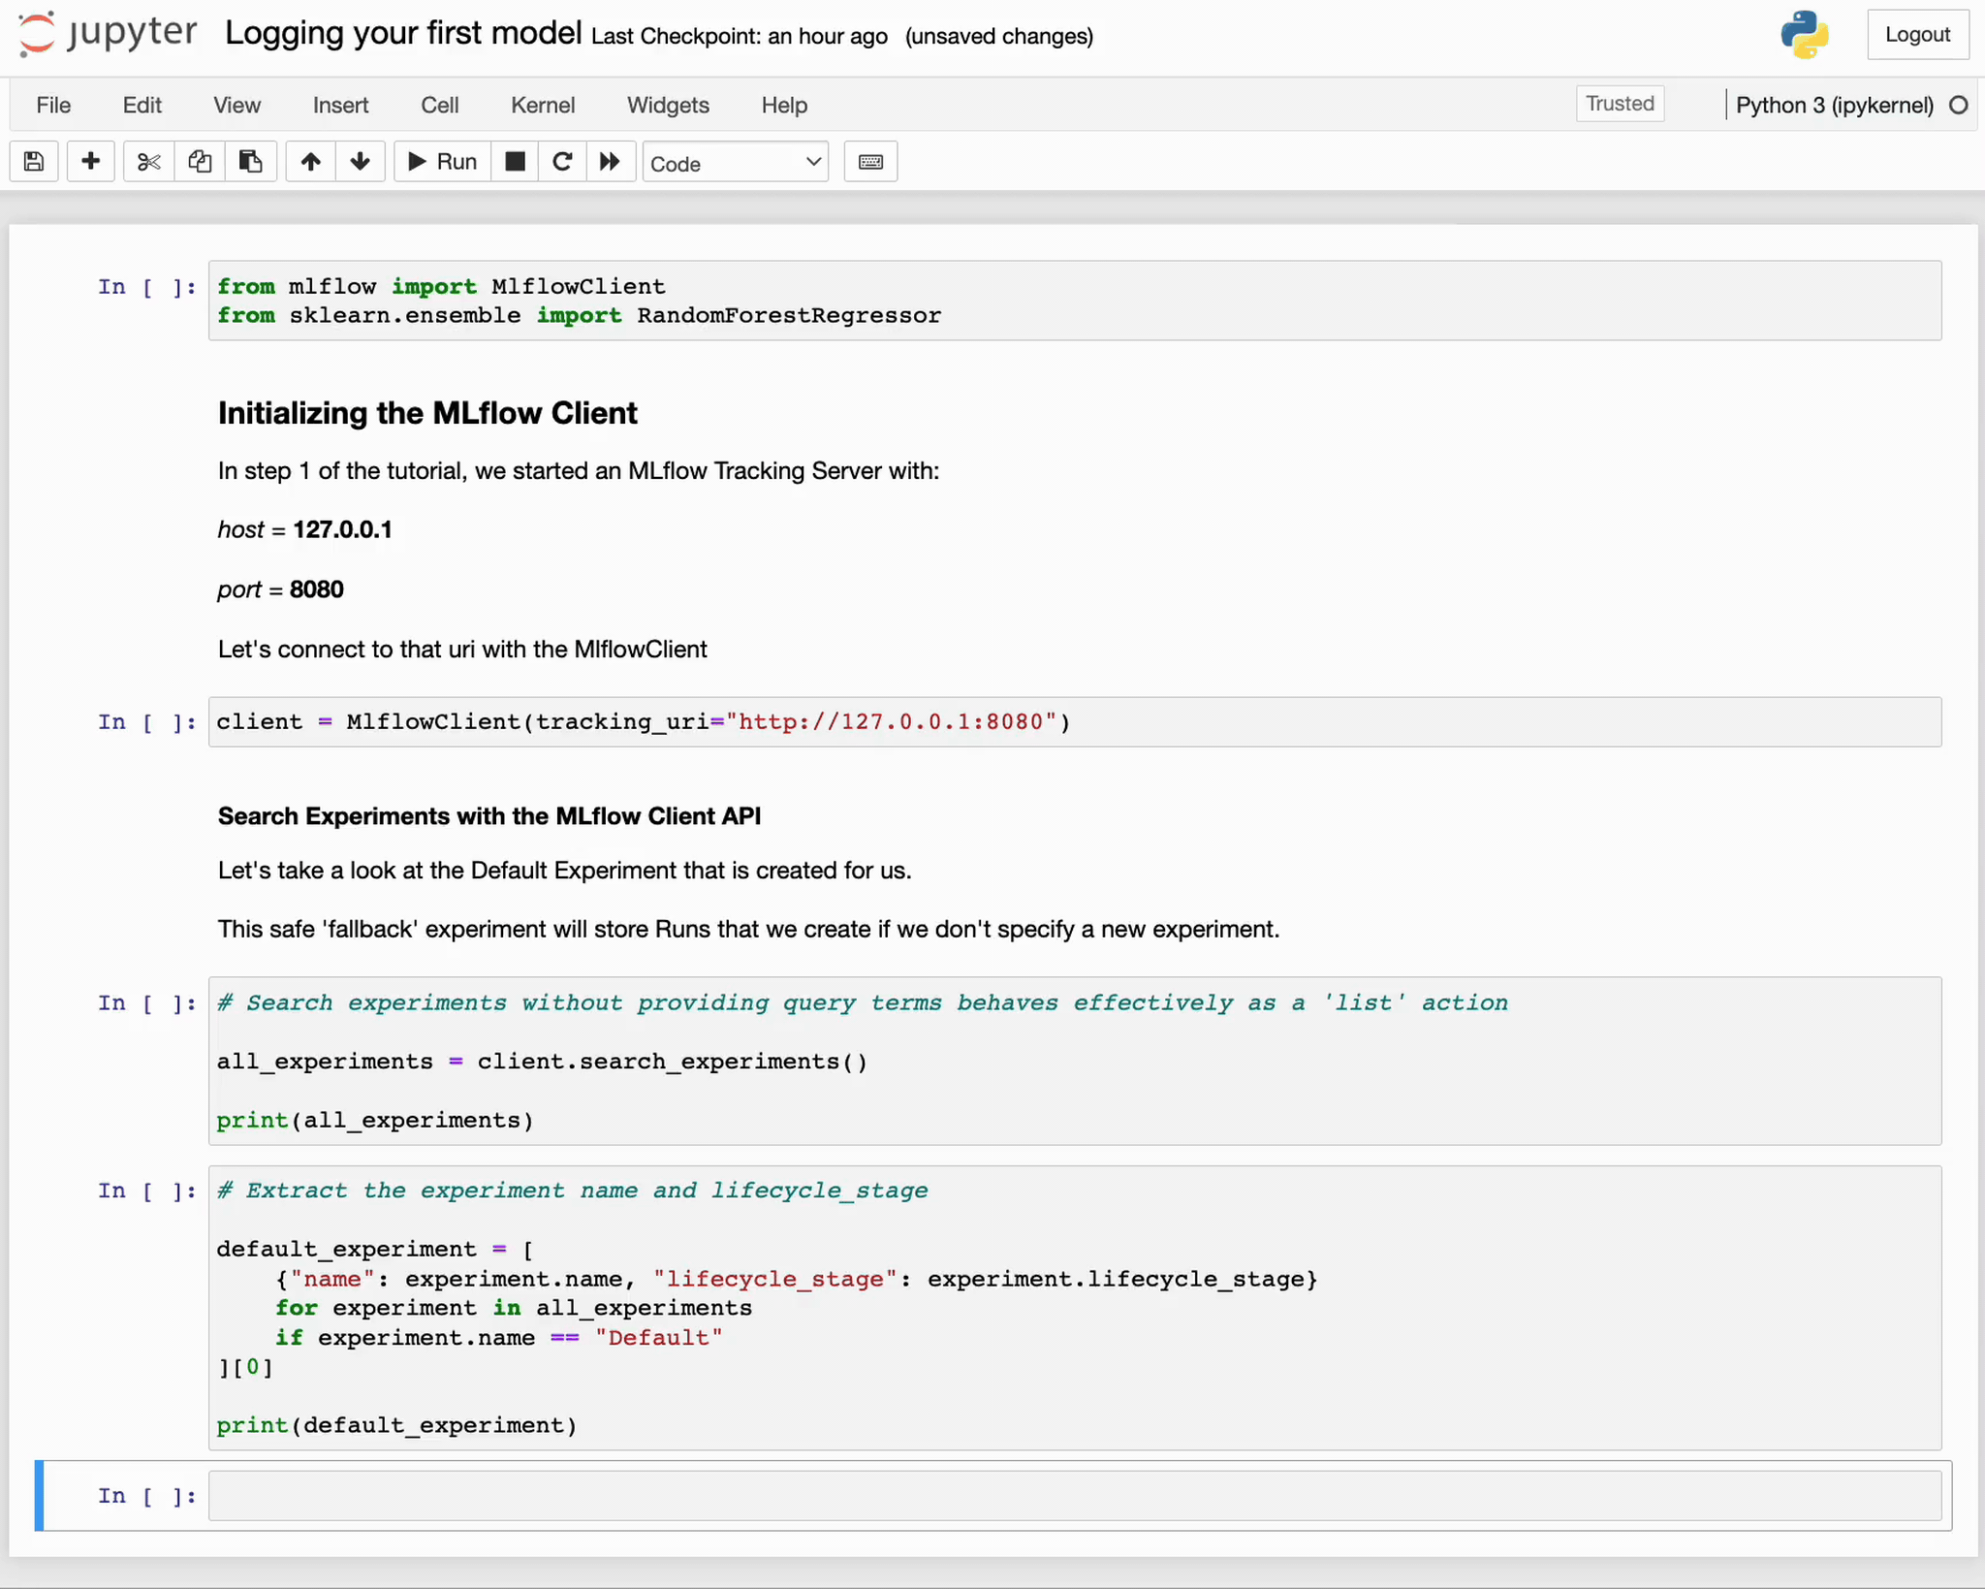
Mlflow Client API
Client API

Slide 28
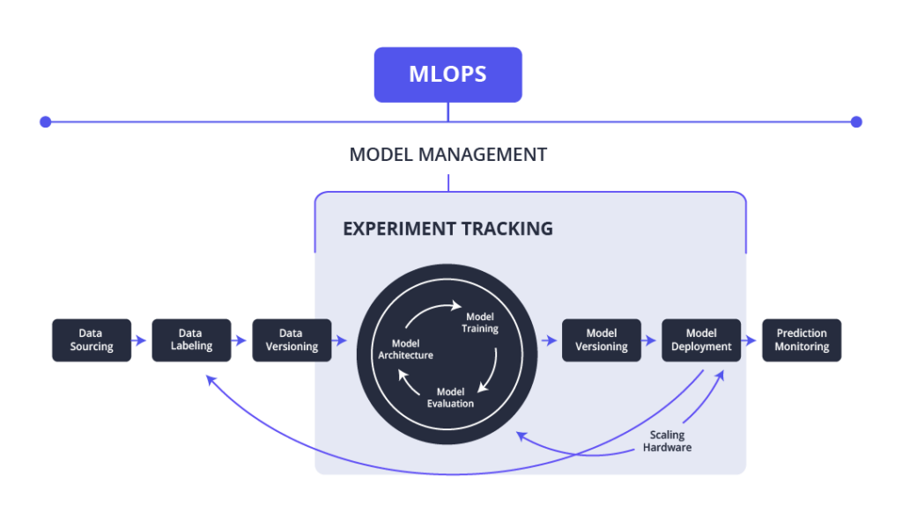







What is Experiment Tracking?
Experiment tracking refers to the process of logging the different experiments, including model parameters, hyperparameters, metrics, and the output of each run.
Purpose: This practice ensures the reproducibility of machine learning experiments and allows for easy comparison across different experiments to determine the best-performing model.
MLFlow's Role
MLFlow provides integrated tools for managing experiments and results, making it easier to track the history of model changes, and providing a centralized system for comparison.
Offers detailed views of all experiment runs, helping teams quickly spot which configurations work best.

Slide 29
Setting Up MLFlow for Experiment Tracking
Installation
Install MLFlow: pip install mlflow
Start the MLFlow server: mlflow ui to launch the web interface.
Step-by-Step Guide
Create a New Experiment: mlflow.create_experiment("ExperimentName")
Track Experiment Parameters: Use mlflow.log_param() for hyperparameters.
Log Metrics: Track the performance with mlflow.log_metric().
Log Artifacts: Save important artifacts like models or plots using mlflow.log_artifact().
Objective: This setup will allow you to monitor and manage model performance and experiment history in a seamless and reproducible manner.

Slide 30
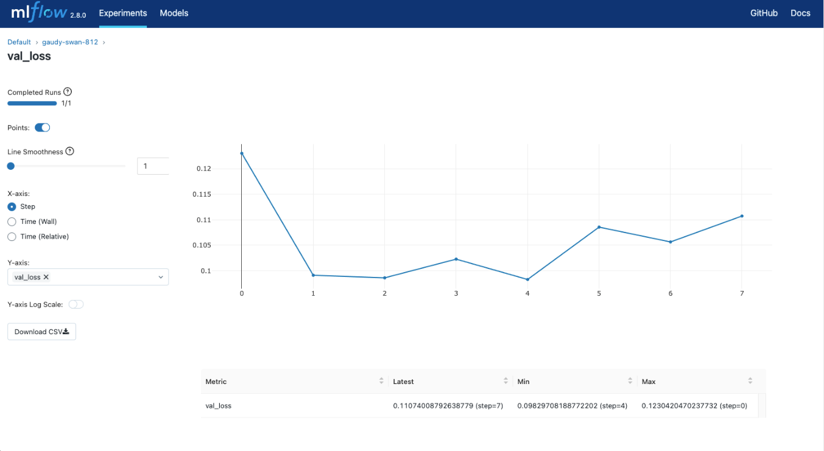
MLflow Tracking
The MLflow Tracking is an API and UI for logging parameters, code versions, metrics, and output files when running your machine learning code and for later visualizing the results. MLflow Tracking provides Python, REST, R, and Java APIs.

Slide 31
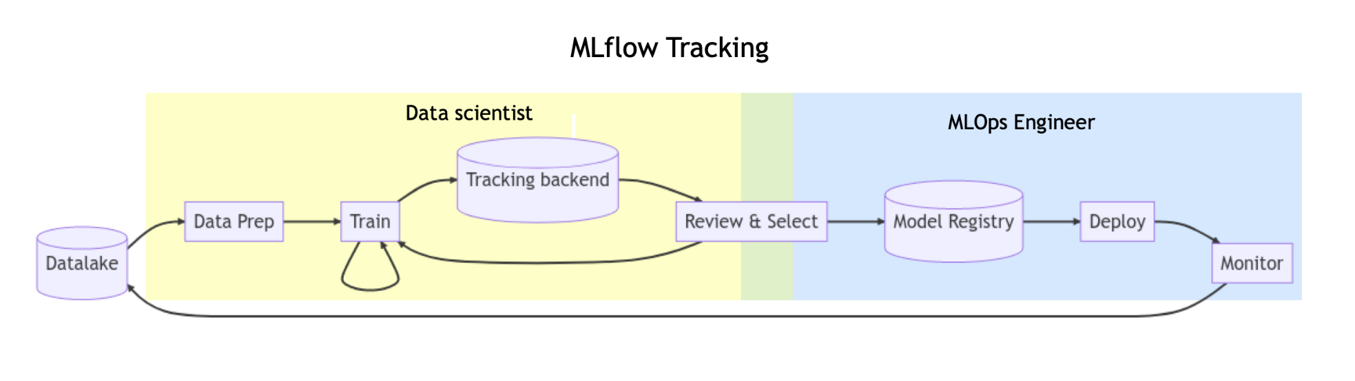





MLflow Tracking
MLflow Tracking in MLOps

Slide 32
MLflow Tracking Example
Step 1: Initial Setup
Start mlflow server over default port or a custom port; set the tracking URI
mlflow server --host 127.0.0.1 --port 8080
import mlflow
# Set our tracking server uri for logging
mlflow.set_tracking_uri(uri="http://127.0.0.1:8080")
# Create a new MLflow Experiment
mlflow.set_experiment("MLflow Quickstart")

Slide 33
MLflow Tracking Example
Step 2: Train a model and prepare metadata for logging
import pandas as pd
from sklearn import datasets
from sklearn.model_selection import train_test_split
from sklearn.linear_model import LogisticRegression
from sklearn.metrics import accuracy_score, precision_score, recall_score, f1_score
# Load the Iris dataset & Split the data into training and test sets
X, y = datasets.load_iris(return_X_y=True)
X_train, X_test, y_train, y_test = train_test_split( X, y, test_size=0.2, random_state=42 )
# Define the model hyperparameters & train the model
params = { "solver": "lbfgs", "max_iter": 1000, "multi_class": "auto", "random_state": 8888, }
lr = LogisticRegression(**params)
lr.fit(X_train, y_train)
# Predict on the test set & calculate metrics
y_pred = lr.predict(X_test)
accuracy = accuracy_score(y_test, y_pred)

Slide 34
MLflow Tracking Example
Step 3: Log the model and its metadata to MLflow
from mlflow.models import infer_signature
# Start an MLflow run
with mlflow.start_run():
mlflow.log_params(params) # Log the hyperparameters
mlflow.log_metric("accuracy", accuracy) # Log the loss metric
# Set a tag that we can use to remind ourselves what this run was for
mlflow.set_tag("Training Info", "Basic LR model for iris data")
# Infer the model signature
signature = infer_signature(X_train, lr.predict(X_train))
# Log the model
model_info = mlflow.sklearn.log_model(sk_model=lr,
artifact_path="iris_model",
signature=signature,
input_example=X_train,
registered_model_name="tracking-quickstart",)

Slide 35
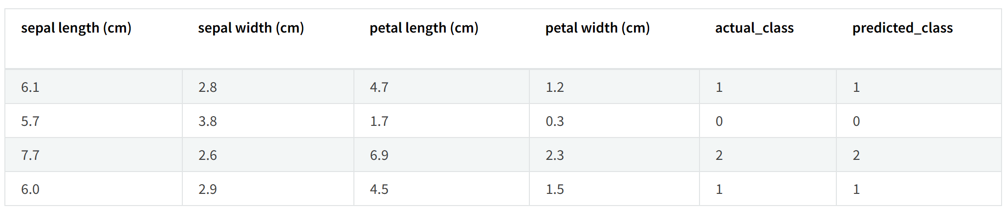
MLflow Tracking Example
Step 4: Load the model as a Python Function (pyfunc) and use it for inference
# Load the model back for predictions as a generic Python Function model
loaded_model = mlflow.pyfunc.load_model(model_info.model_uri)
predictions = loaded_model.predict(X_test)
iris_feature_names = datasets.load_iris().feature_names
result = pd.DataFrame(X_test, columns=iris_feature_names)
result["actual_class"] = y_test
result["predicted_class"] = predictions
result[:4]

Slide 36
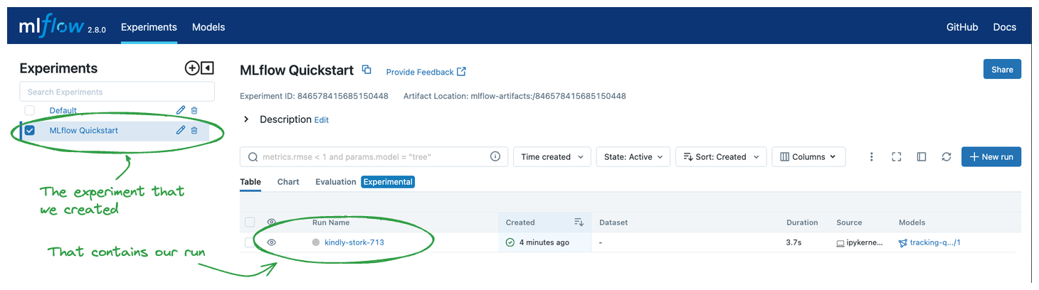
MLflow Tracking Example
Step 5: View the Run in the MLflow UI
Navigate to tracking server at http://127.0.0.1:8080 to view the results in the browser.

Slide 37
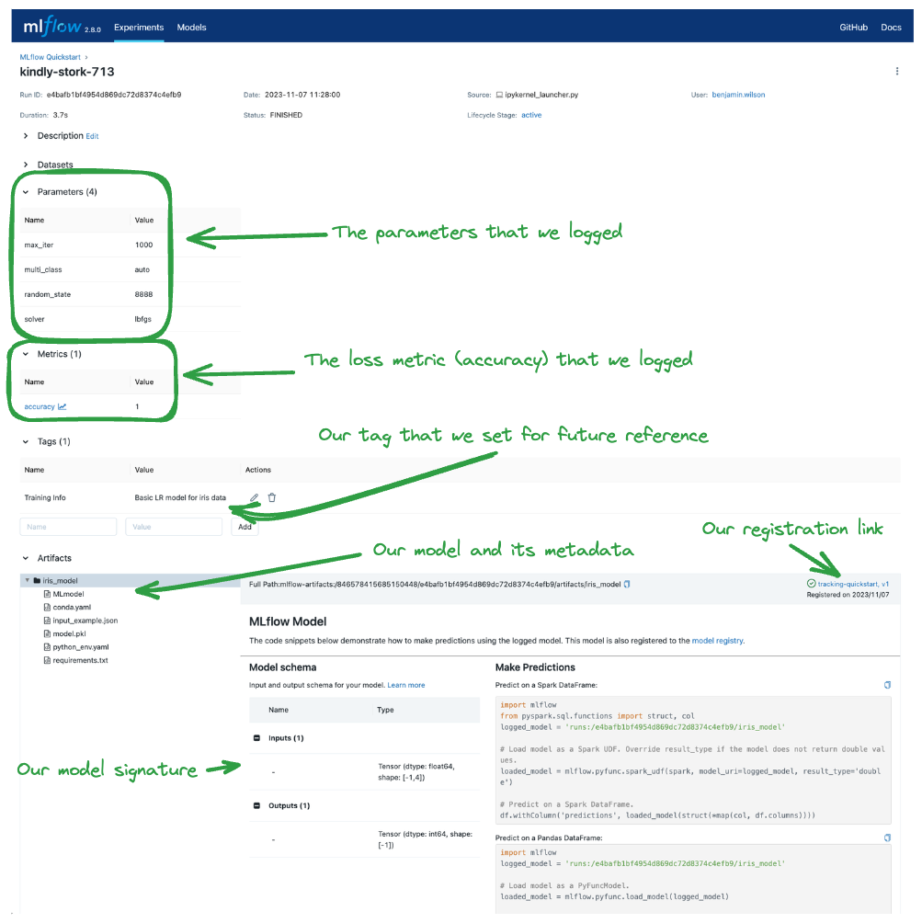
MLflow Tracking Example
Step 5: View the Run in the MLflow UI

Slide 38
What is Model Environment Management?
Managing the environment for ML models means ensuring that all dependencies, libraries, and configurations are properly defined and versioned for consistent execution across all stages.
MLFlow’s Approach
Supports containerization with Docker and conda environments for environment replication.
Tracks dependencies in virtual environments to maintain consistent model deployment in different environments (e.g., development, staging, production).
Why It Matters
Eliminates issues like dependency conflicts and environment mismatch that can affect model performance during deployment.

Slide 39
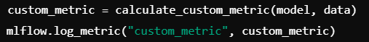
How to Manage Custom Model Metrics in MLFlow
MLFlow allows you to define and log custom metrics that are more suited to the specific needs of your project or business use case.
Example: Logging precision at k, model performance over time, or business-relevant metrics like customer satisfaction.
Implementation
Define custom metrics (e.g., using Python functions) and log them using mlflow.log_metric().
Example
Use Case: Custom metrics provide more meaningful insights that align with the goals of the business, such as improving accuracy in business predictions rather than just raw technical metrics.

Slide 40

Comparing Multiple Models in MLFlow
MLFlow allows you to easily compare different model versions or architectures by tracking various performance metrics across multiple runs.
How to Compare
Log Key Metrics: Log metrics like accuracy, precision, F1-score, etc.
Compare Visualizations: Use MLFlow's built-in web UI to compare multiple models side by side and identify the best-performing models.
Key Benefits
Side-by-side comparisons of models to determine the best configuration.
Traceable results from different versions or different datasets to understand which changes improved model performance.

Slide 41

MLFlow for Model Deployment
Simplified Model Deployment: MLFlow helps streamline the deployment of models by managing both model packaging and deployment pipelines.
Support for Deployment Targets: Models can be deployed to local servers, cloud environments, or edge devices with consistent configurations.
Deployment with MLFlow
Use MLFlow Models to easily serve models for batch prediction or real-time prediction using REST APIs.
Use Case
Deploy a model on a Kubernetes cluster or an AWS SageMaker endpoint for scalable and cost-efficient inference.

Slide 42

Integration with Cloud Platforms (AWS, Azure, GCP)
Cloud Integration: MLFlow integrates seamlessly with popular cloud platforms, such as AWS, Azure, and Google Cloud.
Deployment
Store model artifacts on cloud storage like S3 (AWS) or Azure Blob Storage.
Use cloud computing resources like EC2, Azure ML, or GCP AI Platform to train models and perform inference.
Benefits
Scalable model training and deployment.
Seamless management of environments for models, ensuring consistent performance across cloud platforms.

Slide 43

Monitoring Models Post-Deployment
Model Monitoring: After deployment, models need to be continuously monitored for performance degradation, data drift, or unexpected behavior.
MLFlow’s Role
Use MLFlow’s REST API and monitoring tools to track models in production and alert on performance changes.
Automated Alerts: Set thresholds for key metrics to trigger automatic alerts if performance drops.
Example: Use Prometheus for monitoring and Grafana for visualizing key metrics in real-time.

Slide 44
The Role of Artifacts in MLFlow
What are Artifacts?
Artifacts in MLFlow are important files generated during model training, such as model files, evaluation reports, and logs.
Significance:
Reproducibility
Auditability
Storage
Artifacts make it easy to reproduce experiments and retrain models as needed.
They provide a clear record of what was used during training and deployment.
Use mlflow.log_artifact() to log these files in the artifact store for future reference.

Slide 45
Automating Model Retraining with MLFlow
Model Retraining: Automate the retraining process by integrating MLFlow with scheduling tools like Airflow, Kubeflow, or MLFlow’s native scheduler.
Triggering Retraining: Automatically trigger retraining based on data drift, model performance degradation, or regular time intervals.
Use Case
Retrain models with updated data sets to maintain model accuracy and relevance.

Slide 46

















